Slide 1
Citi Bike Data Analysis
By Opeyemi David Adedapo

Slide 2
Project Goal:
To better understand the behavior of Citi Bike’s customer base (both one-time users and subscribers) and how they use Citi Bikes
This will help us to:
Identify where more bikes should be installed
Create targeted marketing campaigns that will appeal to different customer segments

Slide 3
Key questions:
What are the most popular pick-up locations across the city for Citi Bike rental?
How does the average trip duration vary across different age groups?
Which age group rents the most bikes?
How does bike rental vary across the two user groups (one-time users vs long-term subscribers) on different days of the week?
Does the factor of user age impact the average bike trip duration?

Slide 4
Findings & Insights

Slide 5
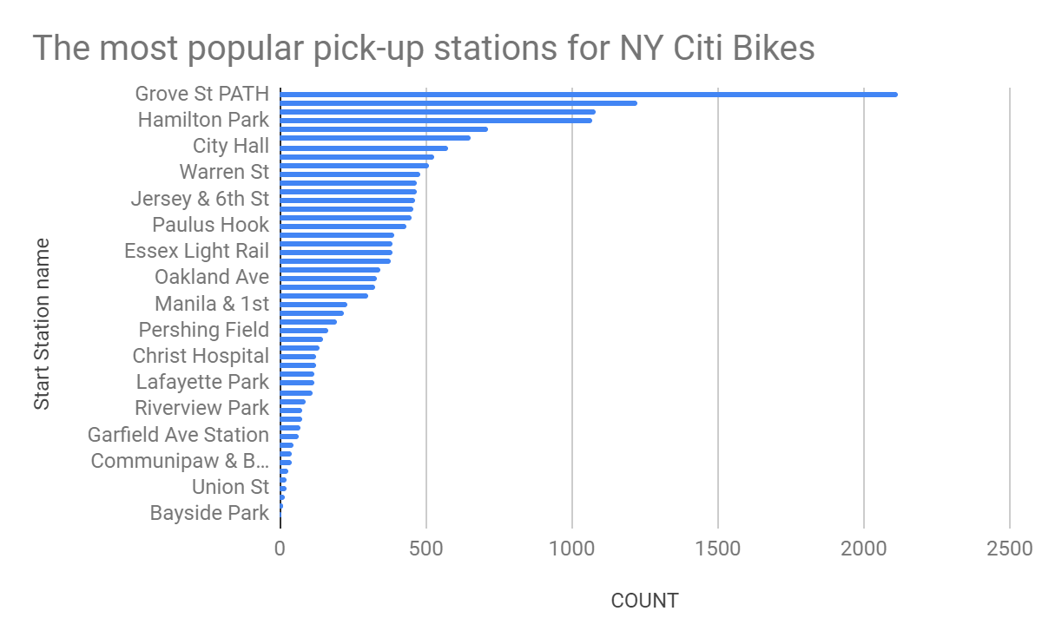
What are the most popular Citi Bike pick-up locations?

Slide 6
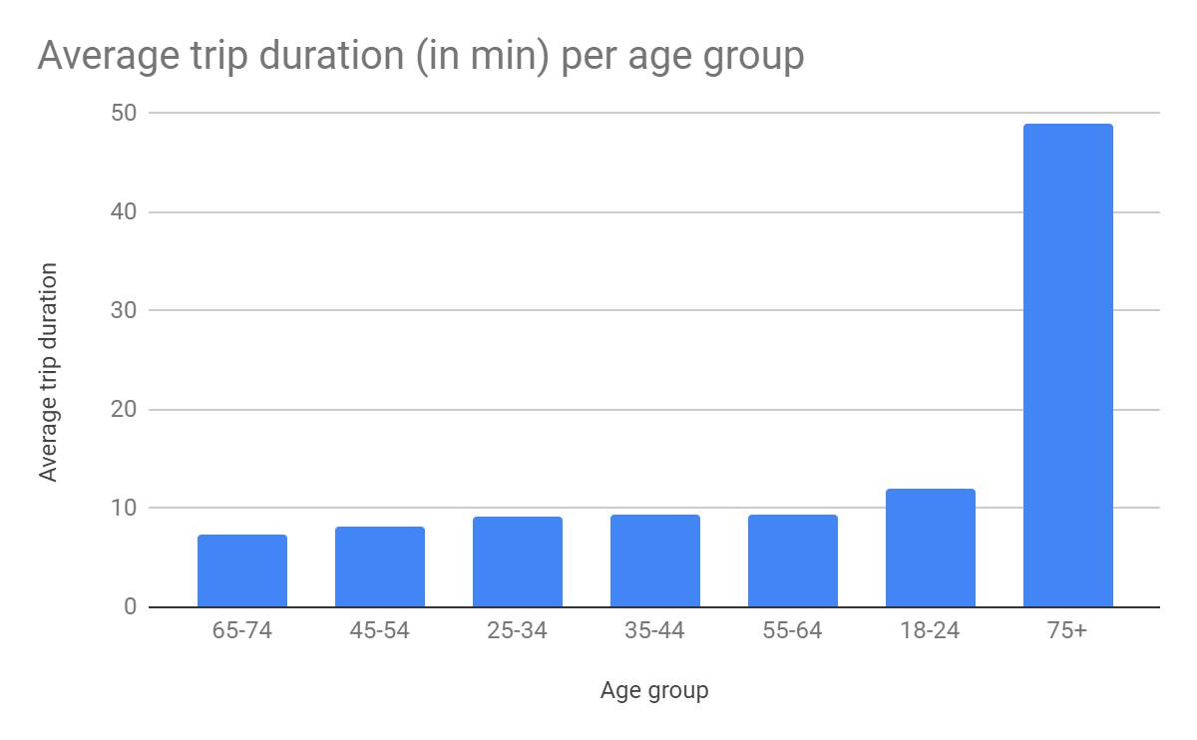
2. How does the average trip duration vary across different age groups?
75+ age group has the most of average trip duration while 65 - 74 age group has the least

Slide 7
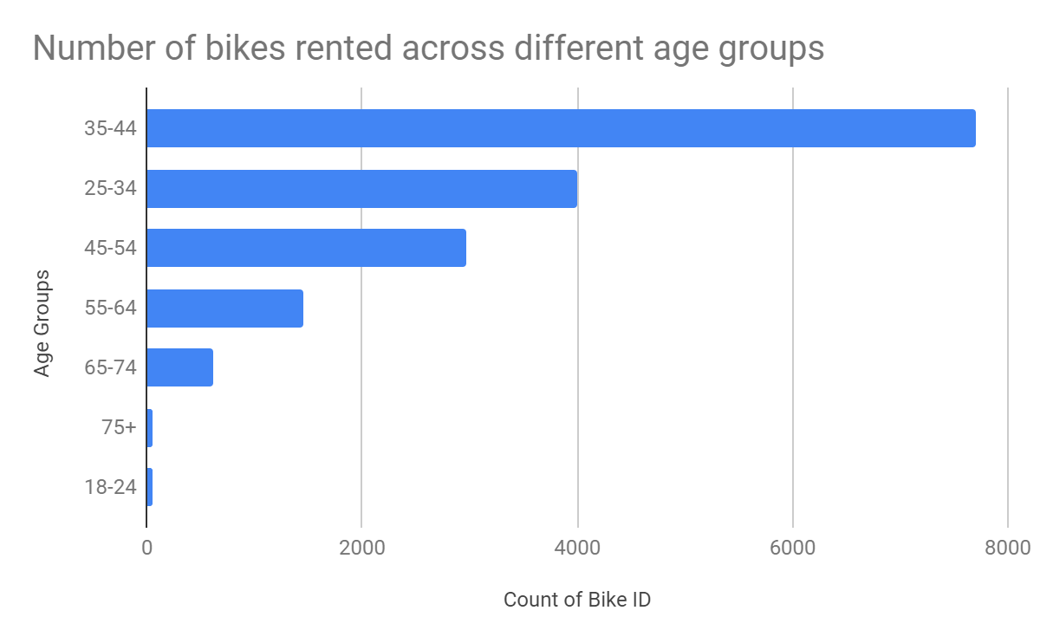
3. Which age group rents the most bikes?
Age range 35 - 44 rented the most number of bikes while 75+ and 18 - 24 age range have the least rented number of bikes

Slide 8
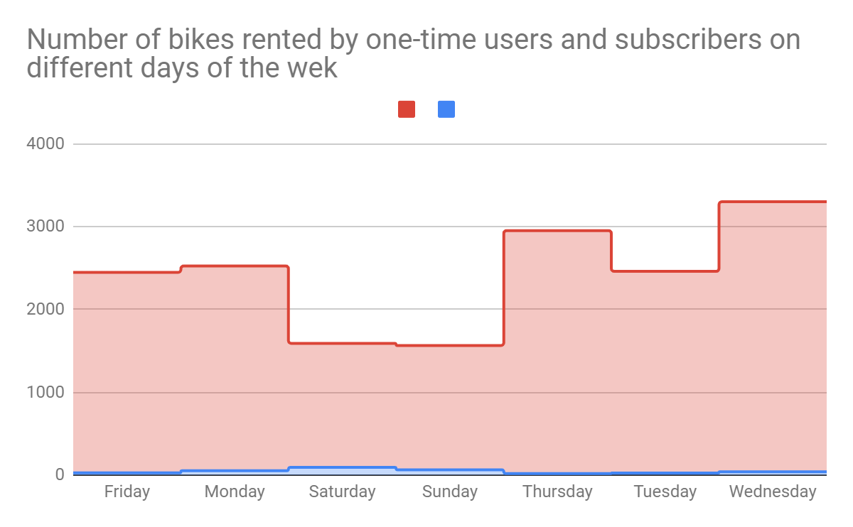
4. How does bike rental vary across the two user groups (one-time users vs long-term subscribers) on different days of the week?
The blue chart is for one time users while the red is for long term subscribers. One time users peak on Saturdays and Sundays while long term subscribers dipped on those days but peak on Wednesdays

Slide 9
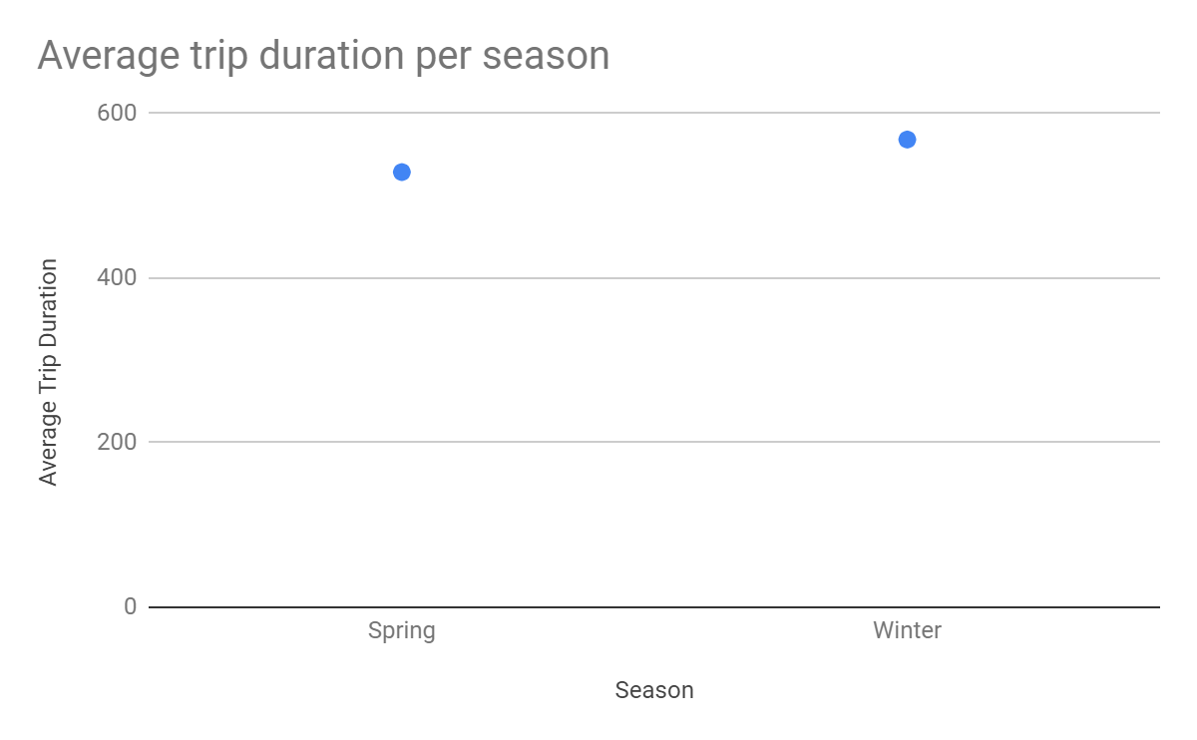
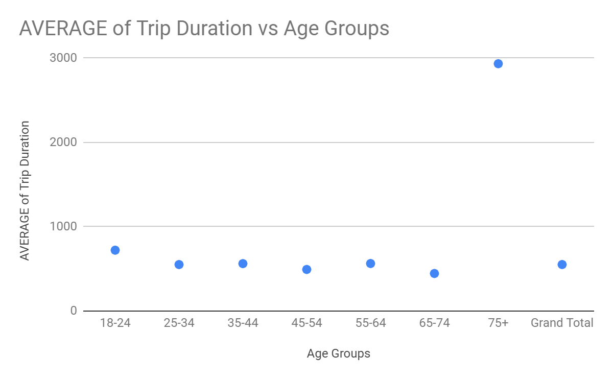
5. Do factors like weather and age impact the average bike trip duration?
Both spring and winter seasons do not affect the average trip as both are almost the same range.
There is a huge rise in average trip duration of 75+ age range compared to other age range

Slide 10
Summary

Slide 11
Summary of findings:
Top 5 pick-up locations for bikes:
Grove St Path, Exchange Place, Sip Ave, Hamilton Park, & Morris Canal
Customer base:
Based on your findings, how would you describe Citi Bike’s customer base? Think in terms of characteristics like age and user type
Citi Bike customer behavior:
Who takes the longest and shortest trips on average?

Slide 12
Actions & Recommendations

Slide 13
Recommended actions:
Product recommendations:
Install more bikes at ...
Marketing recommendations:
The Citi Bike customer base is mostly [user type]...aged between..., who are most active .[weekday or weekends?]... This tells us that they are probably people who live in New York and use Citi Bikes to commute. Marketing and advertising campaigns should therefore target this particular demographic.

Slide 14
Thank you!

